Slide 1
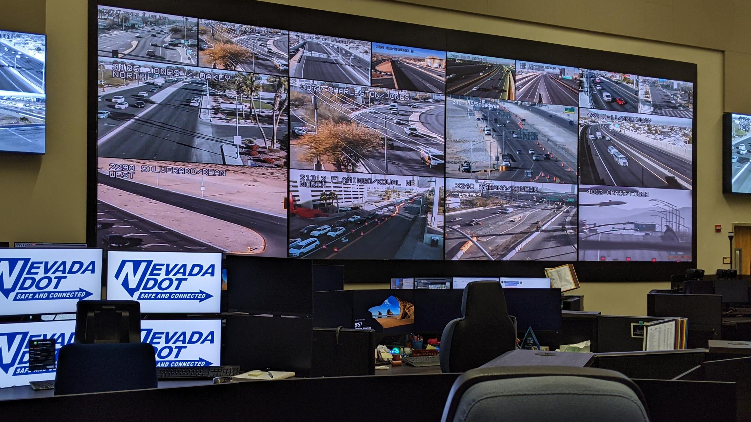

2024 Nevada Transportation Conference
John Peñuelas, Jr., P.E., PTOE
Director of Engineering Services
RTC Streets and Highways

Slide 2
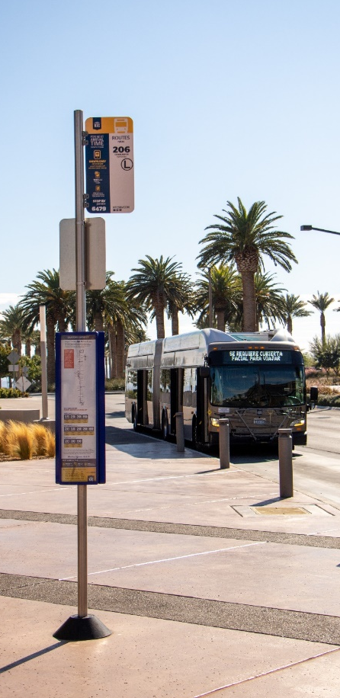
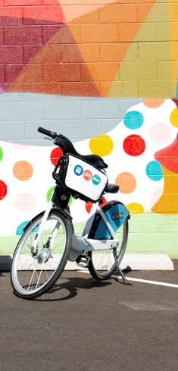

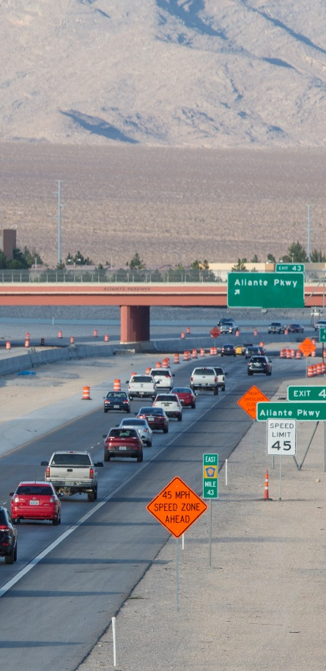

Regional Transportation Commission
of Southern Nevada
Transit
Bicycling
Planning
Roadway Funding
Traffic Management
Notes:
First, let me tell you a bit more about the RTC.
Our fundamental role is to connect people and connect them safely. We touch every cornerstone of the community when it comes to transportation,
The RTC is the transit provider for the region, and we also oversee the bike share system in downtown Las Vegas.
The RTC is also the regional planning agency, otherwise known as the Metropolitan Planning Organization (MPO), and we work with all the local jurisdictions to plan, design and construct roadway infrastructure as well as fund those projects.
Lastly, we are traffic managers, we coordinate traffic signals, and manage dynamic message signs and ramp meters for the region.
This makes us quite unique that we have all these operations under one roof, and that enables us to be more efficient and effective as the transportation agency for Southern Nevada.

Slide 3
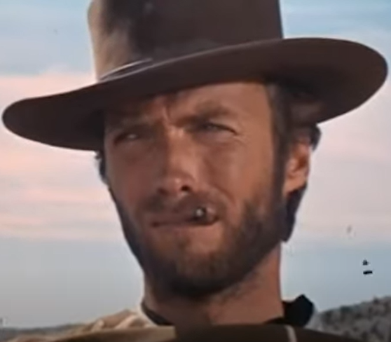
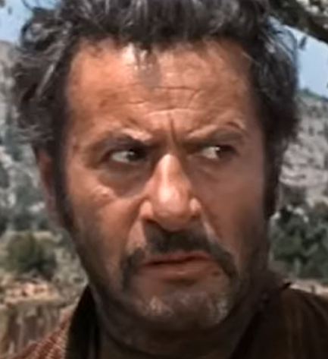

Road Diets
The Good
The Bad
The Ugly

Slide 4
What is a Road Diet?
“Removing travel lanes from a roadway and utilizing the space for other uses and travel modes.”
Rosales, J., Road Diet Handbook: Setting Trends for Livable Streets, Institute of Transportation Engineers, Washington, DC, 2006.

Slide 5
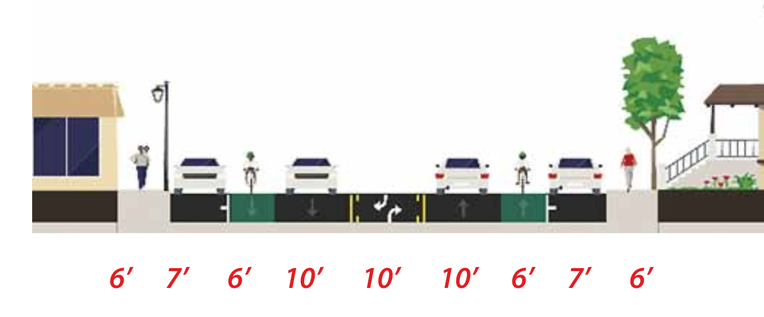
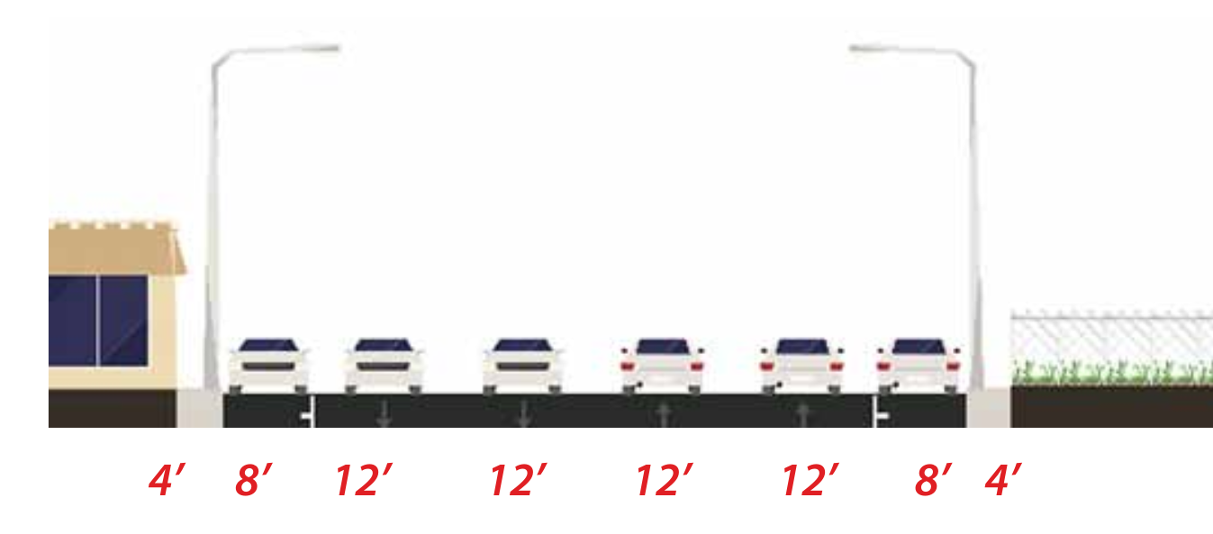
What is a Road Diet?

Slide 6
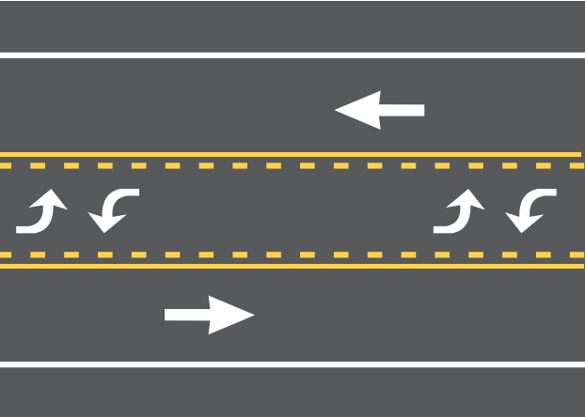
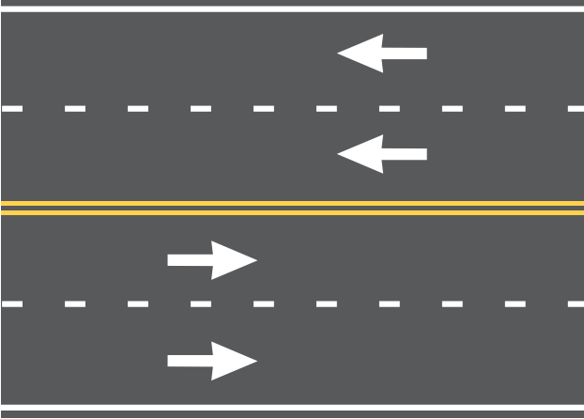
What is a Road Diet?

Slide 7
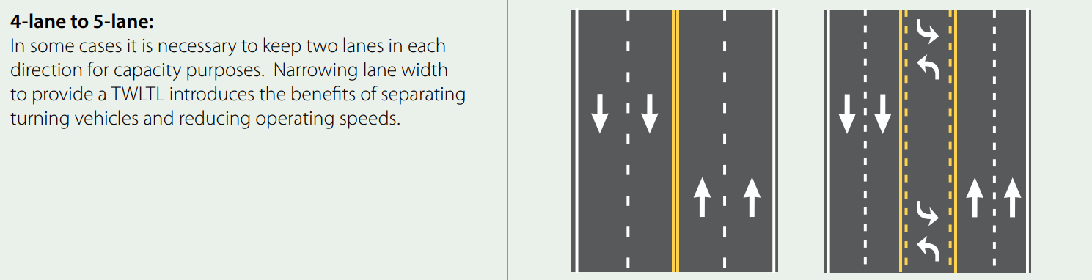
Other Reconfigurations

Slide 8
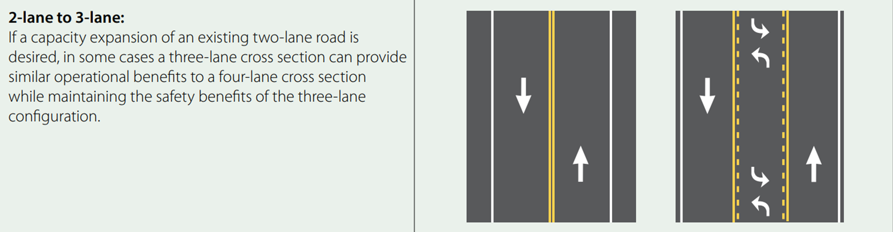
Other Reconfigurations

Slide 9
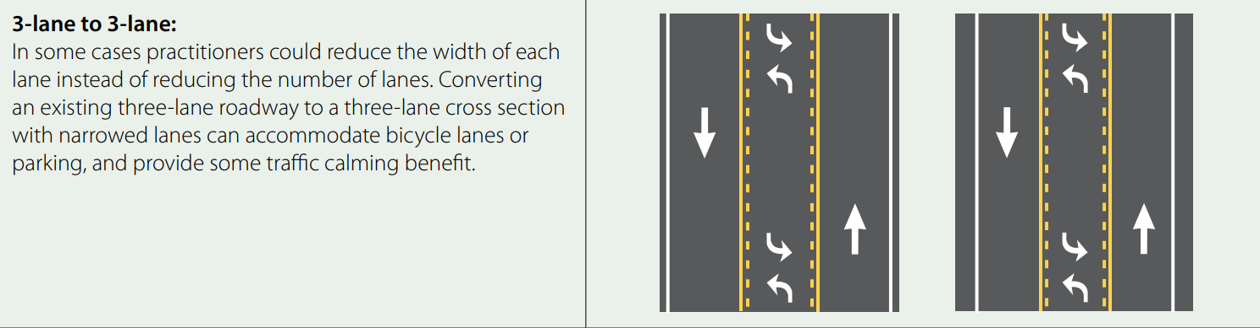
Other Reconfigurations

Slide 10
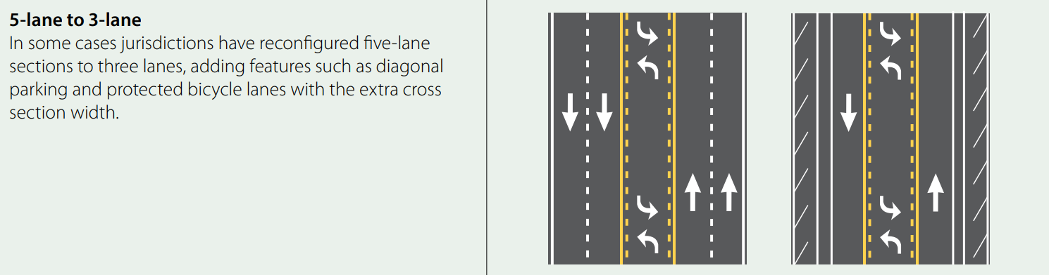
Other Reconfigurations

Slide 11
The Good
Reduction in left turn and rear-end crashes
Reduction in right-angle crashes
Fewer lanes for pedestrians to cross
Opportunity to install ped refuge islands, bike lanes and transit stops
Traffic calming with more consistent and slower speeds
Create a safer environment for vulnerable road users

Slide 12
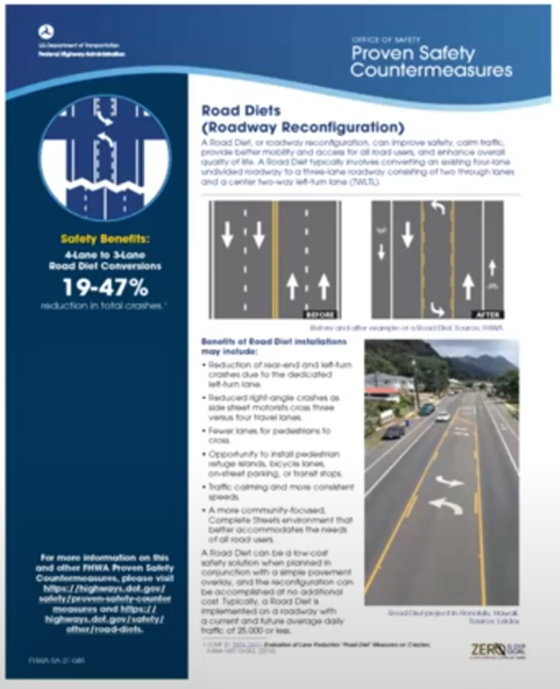

Proven Safety Countermeasure

Slide 13
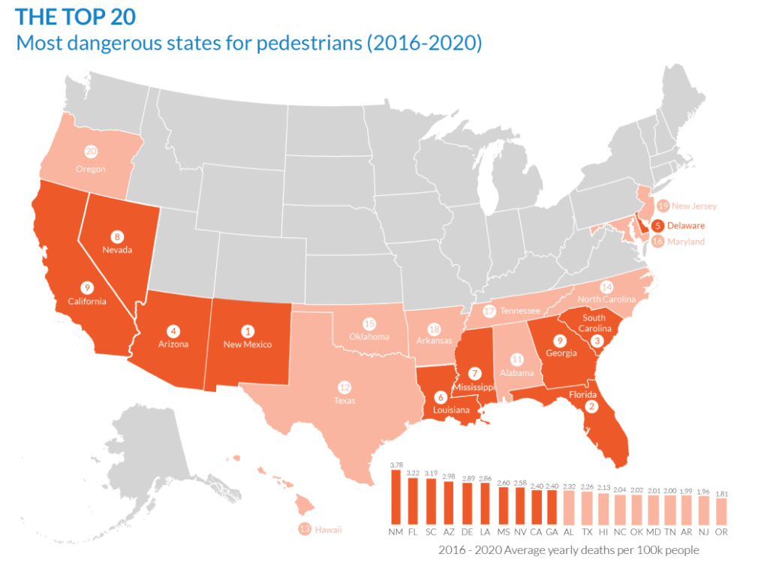

Vulnerable Road Users

Slide 14
The Bad
Bike lanes may reduce parking, depending on design
Fewer travel lanes may cause transit and delivery vehicles to block traffic when stopped
TWLTL could be difficult to access if left turn demand is too high
Buffers between modes may require frequent maintenance
Diversion of trips to parallel streets may occur
People may not see the benefit or misunderstand intent of Road Diet features

Slide 15
Feasibility Determination
Improve safety
Reduce speeds
Mitigate queues associated with left-turning traffic
Improve pedestrian environment
Improve bicyclist accessibility
Enhance transit stops.

Slide 16

Feasibility Determination
“A Context Sensitive Solution is a collaborative, interdisciplinary approach that involves all stakeholders to develop a transportation facility that fits its physical setting and preserves scenic, aesthetic, historic, and environmental resources while maintaining safety and mobility.”

Slide 17
Feasibility Determination
The project satisfies the purpose and needs as agreed to by a full range of stakeholders.
The project is a safe facility for both the user and the community.
The project is in harmony with the community, and it preserves environmental, scenic, aesthetic, historic, and natural resource values of the area.
The project exceeds the expectations of both designers and stakeholders and achieves a level of excellence in people's minds.
The project involves efficient and effective use of the resources of all involved parties.
The project is designed and built with minimal disruption to the community.
The project is seen as having added lasting value to the community.

Slide 18
Determination Factors
Crash Pattern
Speed
Level of Service
Quality of Service
Average Daily Traffic
Peak Hour and Peak Direction
Turning Volumes and Patterns
Frequently Stopping Vehicles
Bicycle Network Connectivity
Nearby Pedestrian Generators

Slide 19
The Ugly
“Education and outreach play a critical role in the success of a Road Diet. Many projects have demonstrated that public opposition can be strong in the early stages of a project. However, with committed stakeholders and an organized education and outreach program, the public can be better informed about the advantages and disadvantages of Road Diets.”
Delaware Valley Regional Planning Commission. Regional Road Diet Analysis Feasibility Assessment. 2008.

Slide 20
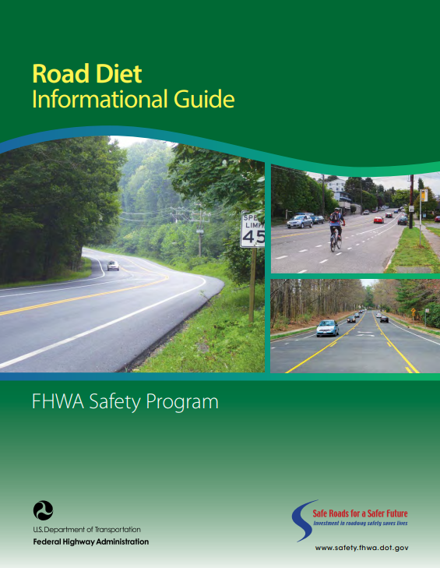
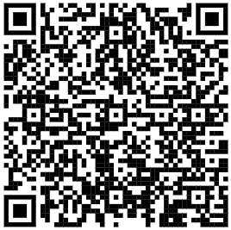
More Information

Slide 21
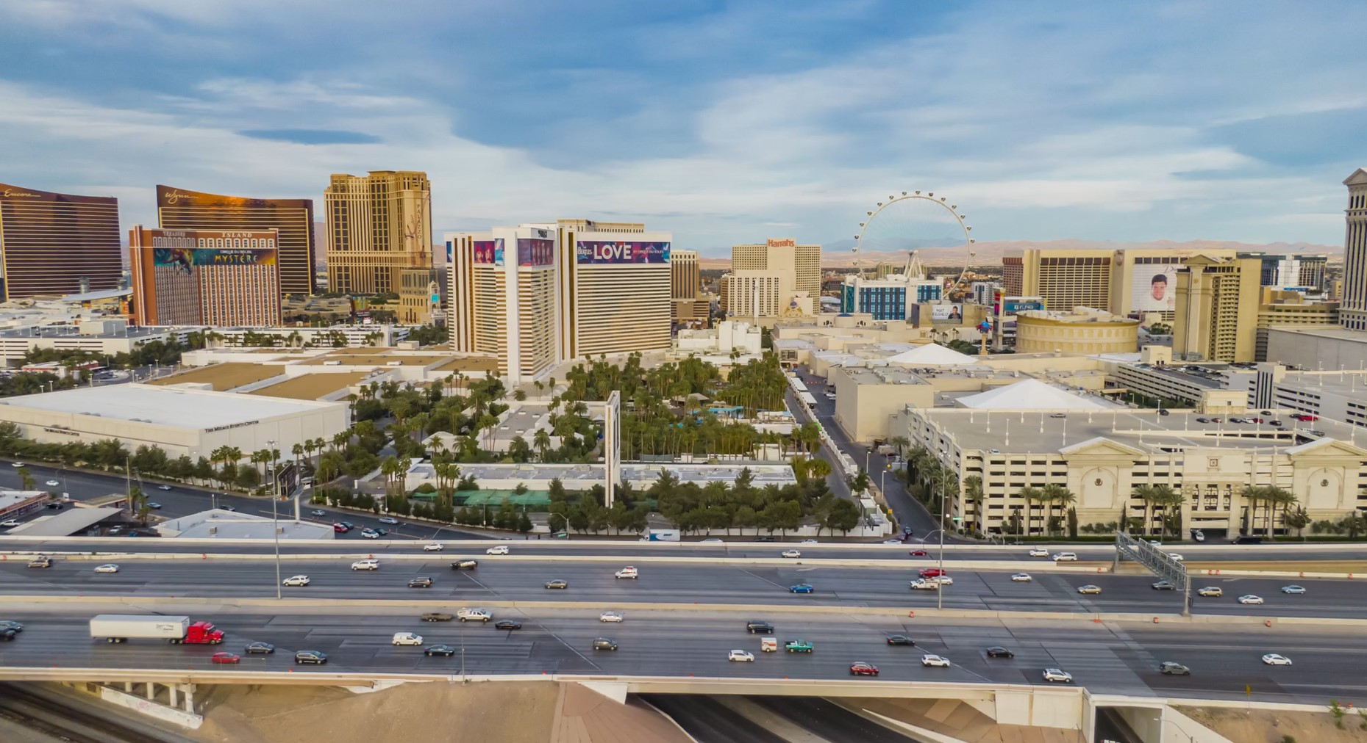

THANK YOU!
PenuelasJ@rtcsnv.com
702-403-9757
Notes:
Thank you. That concludes my presentation. I would be happy to take any questions that you may have.

